Slide 1
All pairs shortest path
The Floyd-Warshall Algorithm
Notes:
Algorithms
CS333 / class 22

Slide 2
All pairs shortest path
The problem: find the shortest path between every pair of vertices of a graph
The graph: may contain negative edges but no negative cycles
A representation: a weight matrix where
W(i,j)=0 if i=j.
W(i,j)=∞ if there is no edge between i and j.
W(i,j)=“weight of edge”
Note: we have shown principle of optimality applies to shortest path problems
Notes:
Algorithms
CS333 / class 22

Slide 3
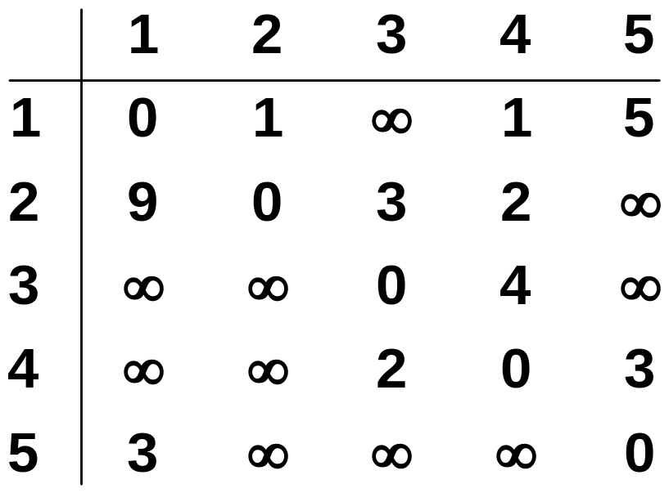
The weight matrix and the graph
1
3
v₁
v₂
9
5
1
2
3
v₅
3
2
v₄
v₃
4
Notes:
Algorithms
CS333 / class 22

Slide 4
All-Pairs Shortest Paths
We now want to compute a table giving the length of the shortest path between any two vertices. (We also would like to get the shortest paths themselves.)
We could just call Dijkstra |V| times, passing a different source vertex each time.
It can be done in Θ(V³), which seems to be as good as you can do on dense graphs.

Slide 5
Doing APSP with SSSP
Dijkstra would take time
Θ(V × V²) = Θ(V³) (standard version)
Θ(V × (VlgV + E)) = Θ(V²lgV + VE)) (modified, Fibonacci heaps),
but doesn’t work with negative-weight edges.

Slide 6
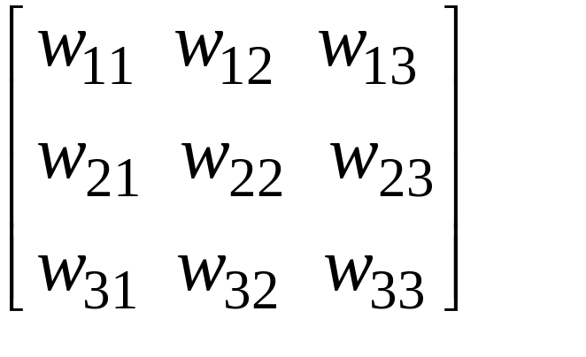
The Floyd-Warshall Algorithm
Represent the directed, edge-weighted graph in adjacency-matrix form.
W= matrix of weights =
w_{ij} is the weight of edge (i, j), or ∞ if there is no such edge.
Return a matrix D, where each entry d_{ij} is δ(i,j).
Could also return a predecessor matrix, P, where each entry π_{ij} is the predecessor of j on the shortest path from i.

Slide 7
The weight matrix and the graph
1
3
v₁
v₂
9
5
1
2
3
v₅
3
2
v₄
v₃
4
Notes:
Algorithms
CS333 / class 22

Slide 8
The subproblems
How can we define the shortest distance d_{i,j} in terms of “smaller” problems?
One way is to restrict the paths to only include vertices from a restricted subset.
Initially, the subset is empty.
Then, it is incrementally increased until it includes all the vertices.
Notes:
Algorithms
CS333 / class 22

Slide 9
The subproblems
Let D^{(k)}[i,j]=weight of a shortest path from v_{i} to v_{j} using only vertices from {v₁,v₂,…,v_{k}} as intermediate vertices in the path
  D⁽⁰⁾=W
  D^{(n)}=D which is the goal matrix
How do we compute D^{(k)} from D^{(k-1)} ?
Notes:
Algorithms
CS333 / class 22

Slide 10
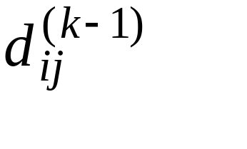
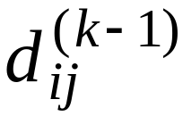
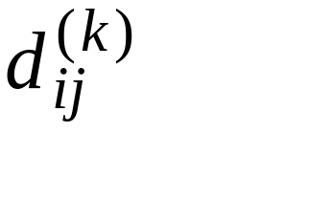
Floyd-Warshall: Idea
Consider intermediate vertices of a path:
i
j
Say we know the length of the shortest path from i to j whose intermediate vertices are only those with numbers 1, 2, ..., k-1. Call this length
Now how can we extend this from k-1 to k? In other words, we want to compute . .Can we use , and if so how?

Slide 11
Floyd-Warshall Idea, 2
k
i
j
Two possibilities:
1. Going through the vertex k doesn’t help— the path through vertices 1...k-1 is still the shortest.
2. There is a shorter path consisting of two subpaths, one from i to k and one from k to j. Each subpath passes only through vertices numbered 1 to k-1.

Slide 12
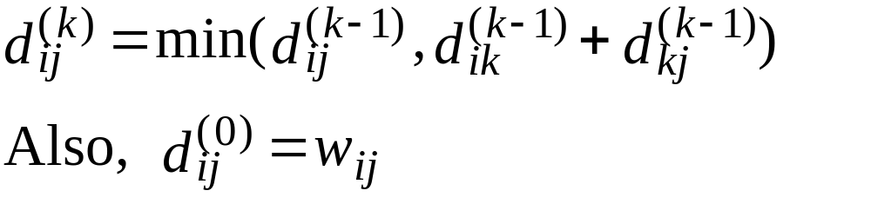
Floyd-Warshall Idea,3
Thus,
(since there are no intermediate vertices.)
When k = |V|, we’re done.

Slide 13
The Recursive Definition:
Case 1: A shortest path from v_{i} to v_{j} restricted to using only vertices from {v₁,v₂,…,v_{k}} as intermediate vertices does not use v_{k}. Then D^{(k)}[i,j]= D^{(k-1)}[i,j].
Case 2: A shortest path from v_{i} to v_{j} restricted to using only vertices from {v₁,v₂,…,v_{k}} as intermediate vertices does use v_{k}. Then D^{(k)}[i,j]= D^{(k-1)}[i,k]+ D^{(k-1)}[k,j].
Shortest path using intermediate vertices
{V₁, . . . V_{k} }
V_{k}
V_{j}
V_{i}
Shortest Path using intermediate vertices { V_{1, . . .} V_{k -1} }
Notes:
Algorithms
CS333 / class 22

Slide 14
The recursive definition
Since
D^{(k)}[i,j]= D^{(k-1)}[i,j] or
D^{(k)}[i,j]= D^{(k-1)}[i,k]+ D^{(k-1)}[k,j].
We conclude:
D^{(k)}[i,j]= min{ D^{(k-1)}[i,j], D^{(k-1)}[i,k]+ D^{(k-1)}[k,j] }.
Shortest path using intermediate vertices
{V₁, . . . V_{k} }
V_{k}
V_{j}
V_{i}
Shortest Path using intermediate vertices { V_{1, . . .} V_{k -1} }
Notes:
Algorithms
CS333 / class 22

Slide 15
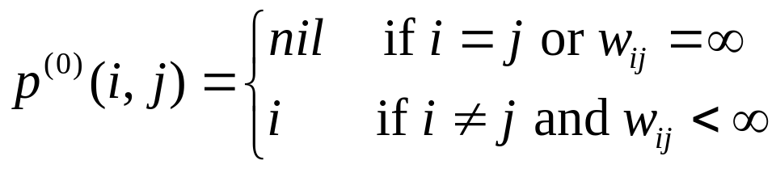
The predecessor matrix p
Used to enable finding a shortest path
Each time that a shorter path from i to j is found the k that provided the minimum is saved (highest index node on the path from i to j)
To print the intermediate nodes on the shortest path a recursive procedure that print the shortest paths from i and k, and from k to j can be used
Notes:
Algorithms
CS333 / class 22

Slide 16
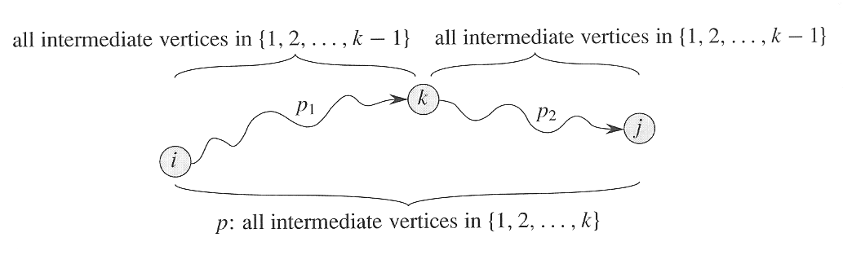
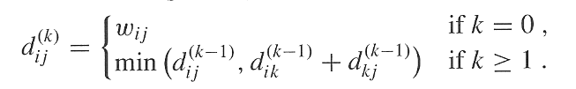
The Floyd-Warshall Algorithm (3)
Recursive solution

Slide 17
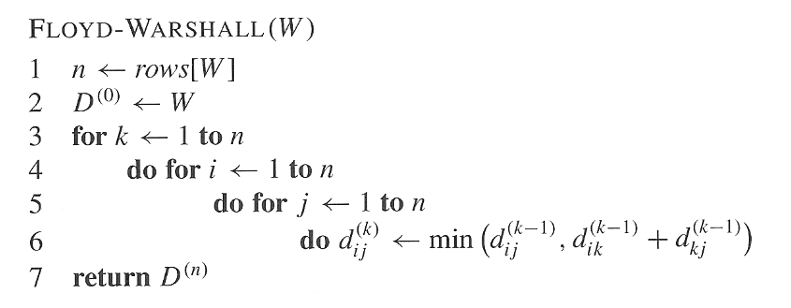
The Floyd-Warshall Algorithm (4)
Computing the shortest-path weights bottom up
O(1)
Time complexity Θ(n³)

Slide 18
Computing predecessor matrix
How do we compute the predecessor matrix?
  Initialization:
  Updating:
Floyd-Warshall(W[1..n][1..n])
01 …
02 for k ← 1 to n do // compute D^{(k)}
03 for i ←1 to n do
04 for j ←1 to n do
05 if D[i][k] + D[k][j] < D[i][j] then
06 D[i][j] ← D[i][k] + D[k][j]
07 P[i][j] ← P[k][j]
08 return D

Slide 19
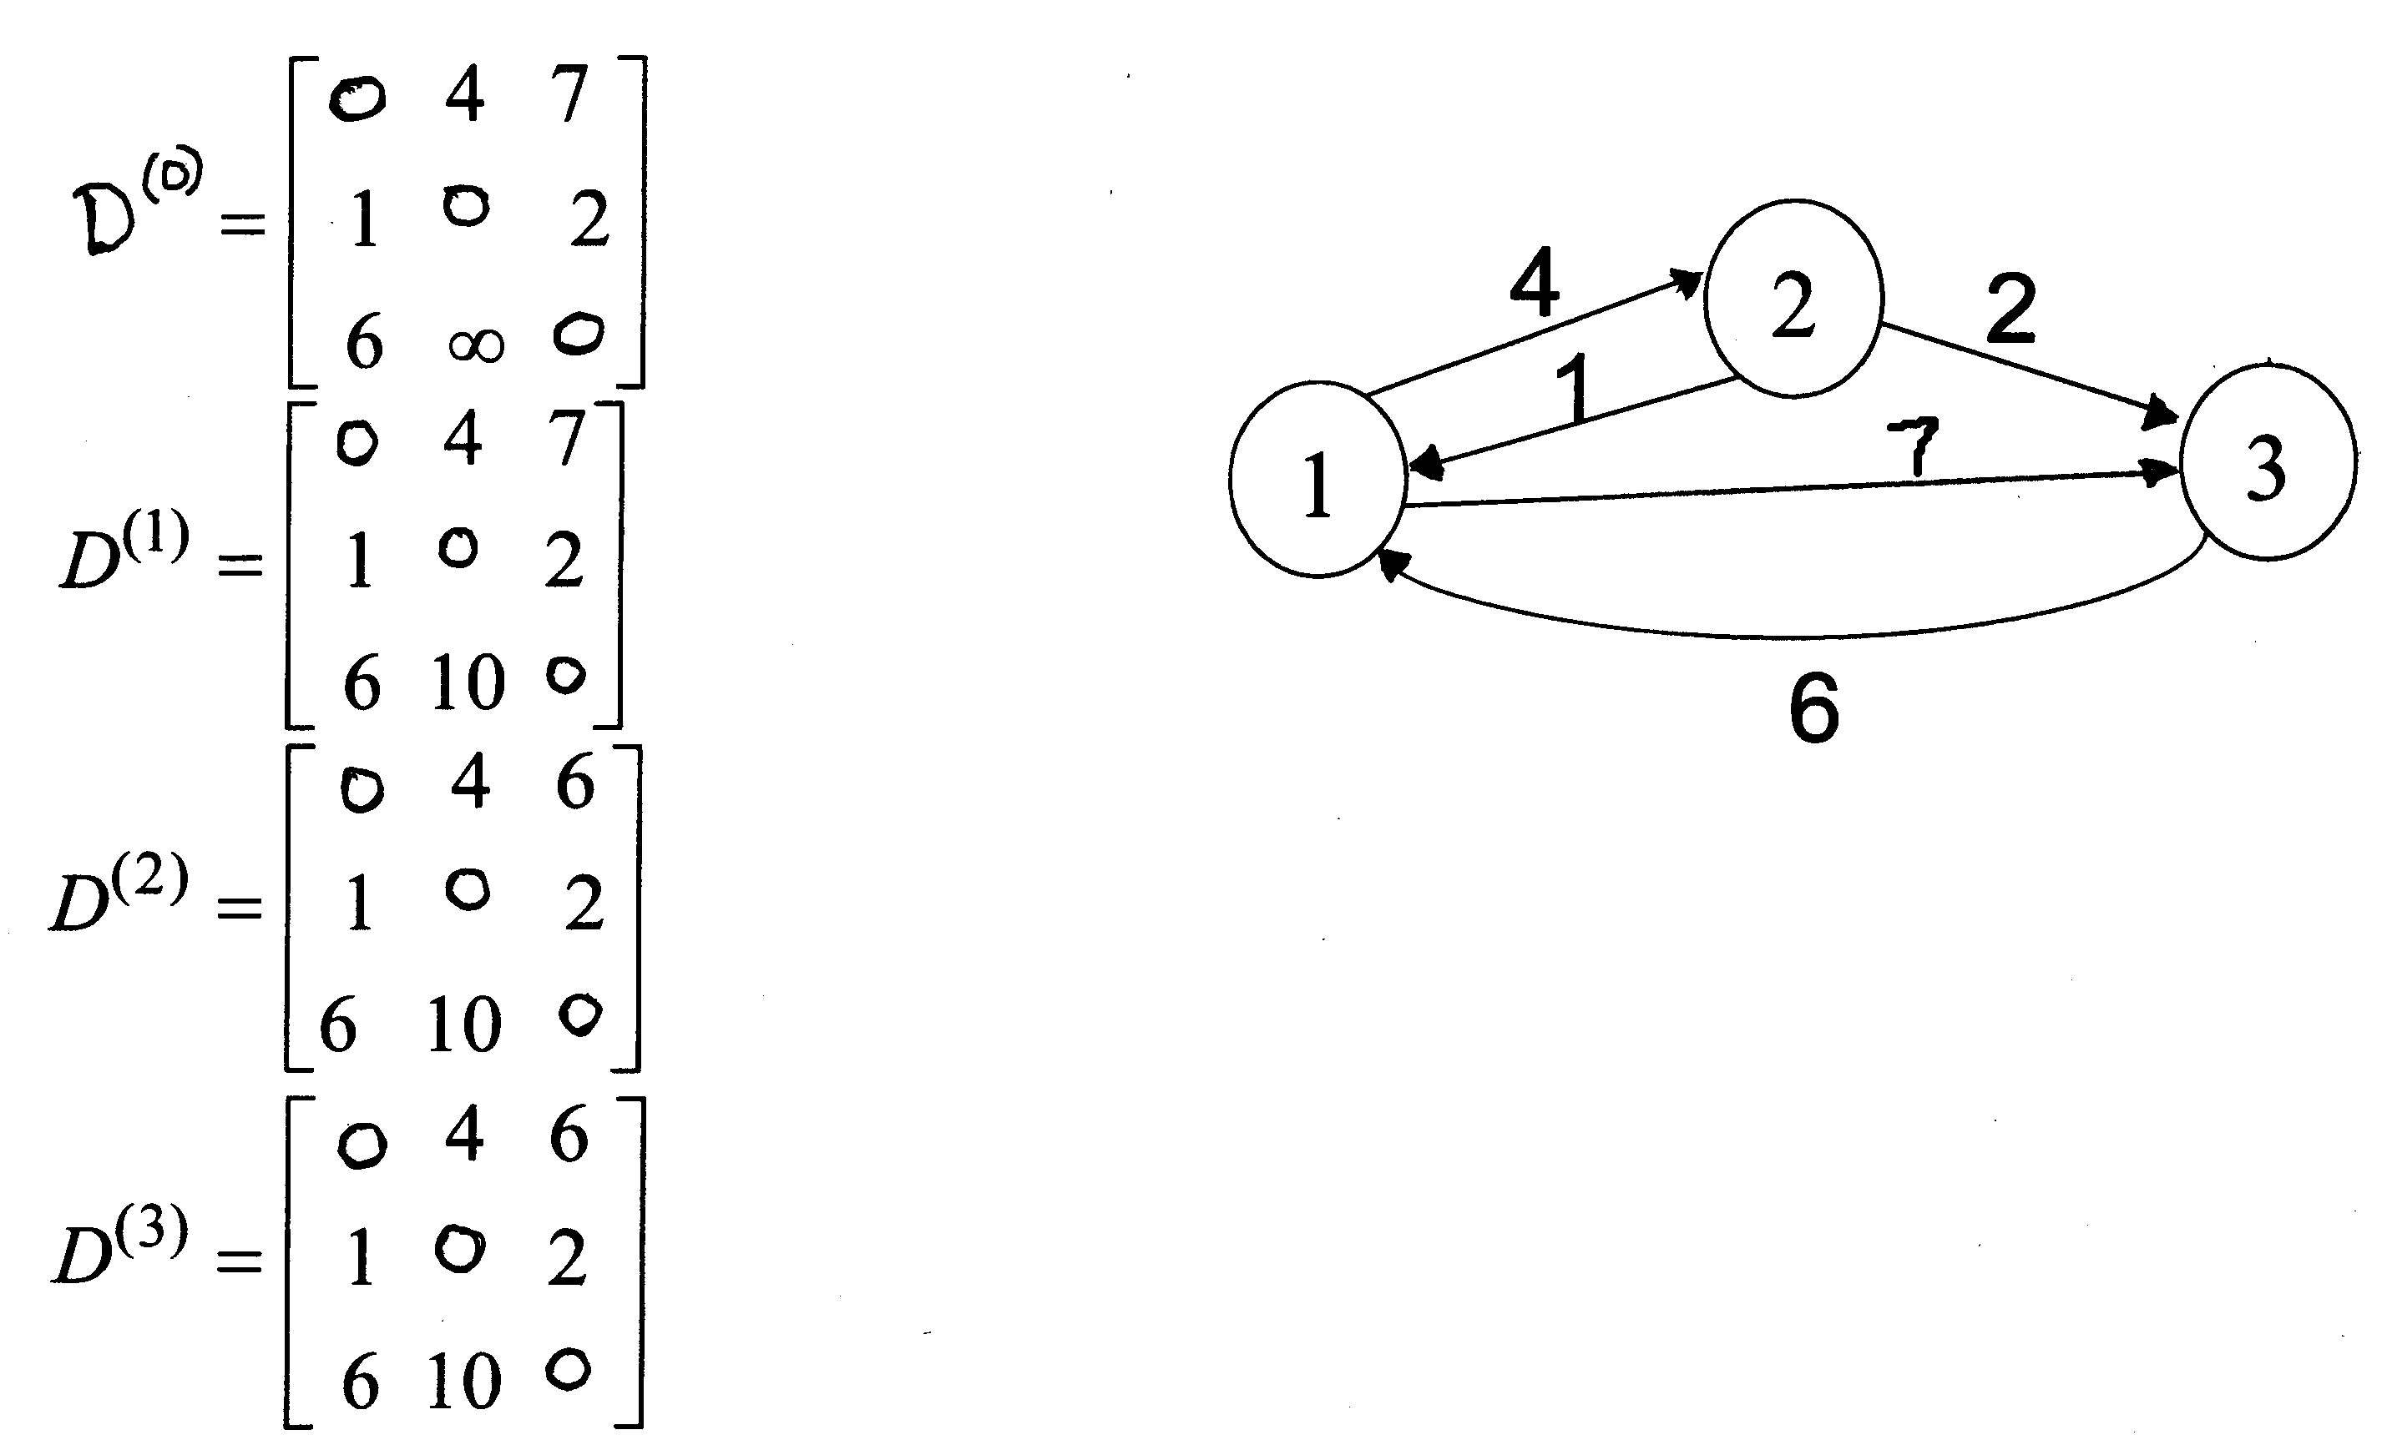
Example 1 of Floyd-Warshall

Slide 20
Example 2 of Floyd-Warshall
2
3
4
1
3
8
2
-5
1
-4
7
5
4
6

Slide 21
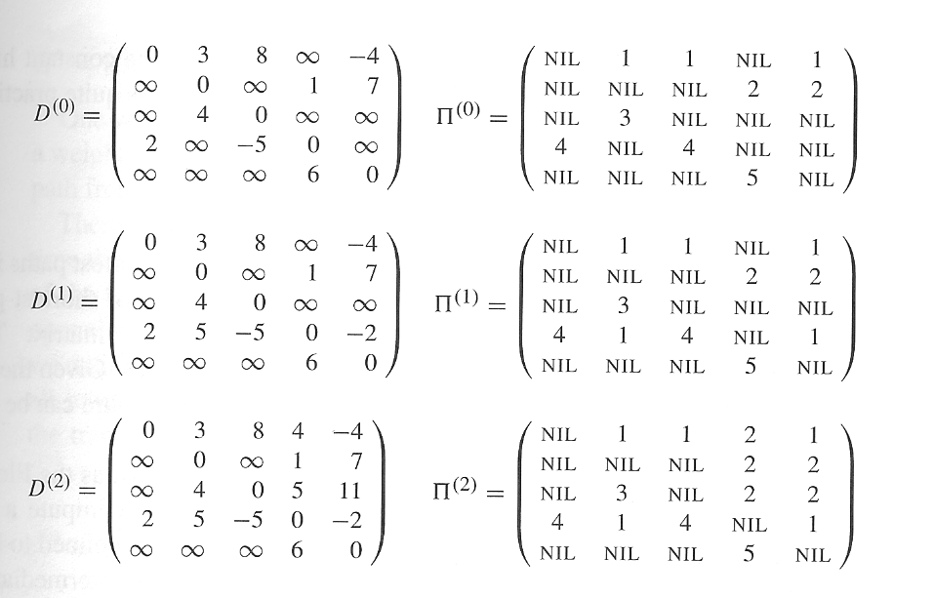
Example 2 of Floyd-Warshall(cont’d)

Slide 22
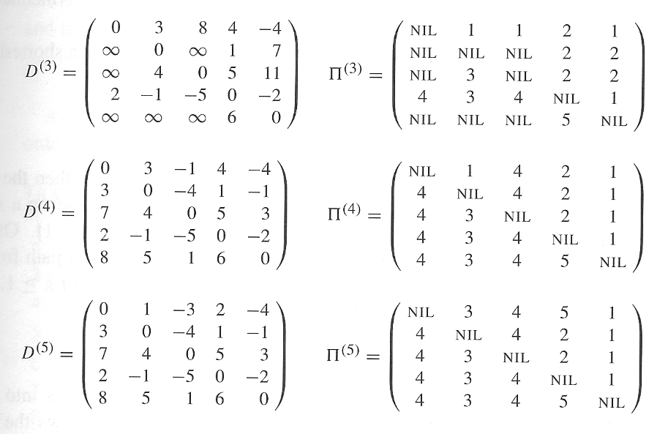
Example 2 of Floyd-Warshall(cont’d)
1->5->4->3 : shortest path -3
1 ->5
5 ~>3

Slide 23
Floyd's Algorithm Using n+1 D matrices
Floyd//Computes shortest distance between all pairs of //nodes, and saves P to enable finding shortest paths
1. D⁰ ← W // initialize D array to W [ ]
2. P ← 0 // initialize P array to [0]
3. for k ← 1 to n
4. do for i ← 1 to n
5. do for j ← 1 to n
6. if (D^{k-1}[ i, j ] > D^{k-1} [ i, k ] + D^{k-1} [ k, j ] )
7. then D^{k}[ i, j ] ← D^{k-1} [ i, k ] + D^{k-1} [ k, j ]
8. P[ i, j ] ← k;
9. else D^{k}[ i, j ] ← D^{k-1} [ i, j ]
Notes:
Algorithms
CS333 / class 22

Slide 24
Example 3
1
2
3
1
0
4
5
W = D⁰ =
1
2
2
0
∞
5
3
∞
-3
0
4
2
3
1
2
3
2
-3
1
0
0
0
P =
2
0
0
0
3
0
0
0
Notes:
Algorithms
CS333 / class 22

Slide 25
k = 1
Vertex 1 can be intermediate node
1
1
2
3
5
D⁰ =
1
0
4
5
4
2
3
2
2
0
∞
2
-3
3
∞
-3
0
1
2
3
1
0
4
5
D¹[2,3] = min( D⁰[2,3], D⁰[2,1]+D⁰[1,3] )
= min (∝, 7)
= 7
D¹[3,2] = min( D⁰[3,2], D⁰[3,1]+D⁰[1,2] )
= min (-3,∝)
= -3
D¹ =
2
2
0
7
3
∞
-3
0
1
2
3
1
0
0
0
P =
2
0
0
1
3
0
0
0
Notes:
Algorithms
CS333 / class 22

Slide 26
k = 2
Vertices 1, 2 can be intermediate
1
2
3
1
5
D¹ =
1
0
4
5
4
2
3
2
2
0
7
2
-3
3
∞
-3
0
1
2
3
1
0
4
5
D²[1,3] = min( D¹[1,3], D¹[1,2]+D¹[2,3] )
= min (5, 4+7)
= 5
D²[3,1] = min( D¹[3,1], D¹[3,2]+D¹[2,1] )
= min (∝, -3+2)
= -1
D² =
2
2
0
7
3
-1
-3
0
1
2
3
1
0
0
0
P =
2
0
0
1
3
2
0
0
Notes:
Algorithms
CS333 / class 22

Slide 27
k = 3
Vertices 1, 2, 3 can be intermediate
1
1
2
3
5
D² =
1
0
4
5
3
4
2
2
2
0
7
2
-3
3
-1
-3
0
1
2
3
1
0
2
5
D³ =
D³[1,2] = min(D²[1,2], D²[1,3]+D²[3,2] )
= min (4, 5+(-3))
= 2
D³[2,1] = min(D²[2,1], D²[2,3]+D²[3,1] )
= min (2, 7+ (-1))
= 2
2
2
0
7
3
-1
-3
0
1
2
3
1
0
3
0
P =
2
0
0
1
3
2
0
0
Notes:
Algorithms
CS333 / class 22

Slide 28
Floyd's Algorithm: Using 2 D matrices
Floyd
1. D ← W // initialize D array to W [ ]
2. P ← 0 // initialize P array to [0]
3. for k ← 1 to n
// Computing D’ from D
4. do for i ← 1 to n
5. do for j ← 1 to n
6. if (D[ i, j ] > D[ i, k ] + D[ k, j ] )
7. then D’[ i, j ] ← D[ i, k ] + D[ k, j ]
8. P[ i, j ] ← k;
9. else D’[ i, j ] ← D[ i, j ]
10. Move D’ to D.
Notes:
Algorithms
CS333 / class 22

Slide 29
Can we use only one D matrix?
D[i,j] depends only on elements in the kth column and row of the distance matrix.
We will show that the kth row and the kth column of the distance matrix are unchanged when D^{k} is computed
This means D can be calculated in-place
Notes:
Algorithms
CS333 / class 22

Slide 30
The main diagonal values
Before we show that kth row and column of D remain unchanged we show that the main diagonal remains 0
D^{(k)}[ j,j ] = min{ D^{(k-1)}[ j,j ] , D^{(k-1)}[ j,k ] + D^{(k-1)}[ k,j ] }
= min{ 0, D^{(k-1)}[ j,k ] + D^{(k-1)}[ k,j ] }
= 0
Based on which assumption?
Notes:
Algorithms
CS333 / class 22

Slide 31
The kth column
kth column of D^{k} is equal to the kth column of D^{k-1}
Intuitively true - a path from i to k will not become shorter by adding k to the allowed subset of intermediate vertices
For all i, D^{(k)}[i,k] =
= min{ D^{(k-1)}[i,k], D^{(k-1)}[i,k]+ D^{(k-1)}[k,k] }
= min { D^{(k-1)}[i,k], D^{(k-1)}[i,k]+0 }
= D^{(k-1)}[i,k]
Notes:
Algorithms
CS333 / class 22

Slide 32
The kth row
kth row of D^{k} is equal to the kth row of D^{k-1}
  For all j, D^{(k)}[k,j] =
  = min{ D^{(k-1)}[k,j], D^{(k-1)}[k,k]+ D^{(k-1)}[k,j] }
  = min{ D^{(k-1)}[ k,j ], 0+D^{(k-1)}[k,j ] }
  = D^{(k-1)}[ k,j ]
Notes:
Algorithms
CS333 / class 22

Slide 33
Floyd's Algorithm using a single D
Floyd
1. D ← W // initialize D array to W [ ]
2. P ← 0 // initialize P array to [0]
3. for k ← 1 to n
4. do for i ← 1 to n
5. do for j ← 1 to n
6. if (D[ i, j ] > D[ i, k ] + D[ k, j ] )
7. then D[ i, j ] ← D[ i, k ] + D[ k, j ]
8. P[ i, j ] ← k;
Notes:
Algorithms
CS333 / class 22

Slide 34
Printing intermediate nodes on shortest path from q to r
path(index q, r)
if (P[ q, r ]!=0)
path(q, P[q, r])
println( “v”+ P[q, r])
path(P[q, r], r)
return;
//no intermediate nodes
else return
Before calling path check D[q, r] < ∞, and print node q, after the call to
path print node r
1
2
3
1
0
3
0
P =
2
0
0
1
3
2
0
0
1
5
4
2
3
2
-3
Notes:
Algorithms
CS333 / class 22

Slide 35

Example
Notes:
Algorithms
CS333 / class 22

Slide 36

The final distance matrix and P
The values in parenthesis are the non zero P values.
Notes:
Algorithms
CS333 / class 22

Slide 37
The call tree for Path(1, 4)
Path(1, 4)
Path(1, 6)
Path(6, 4)
Print v6
P(1, 6)=0
Path(6, 3)
Print
v3
Path(3, 4)
P(6, 3)=0
P(3, 4)=0
The intermediate nodes on the shortest path from 1 to 4 are v6, v3.
The shortest path is v1, v6, v3, v4.
Notes:
Algorithms
CS333 / class 22

Slide 38
END

